Slide 1


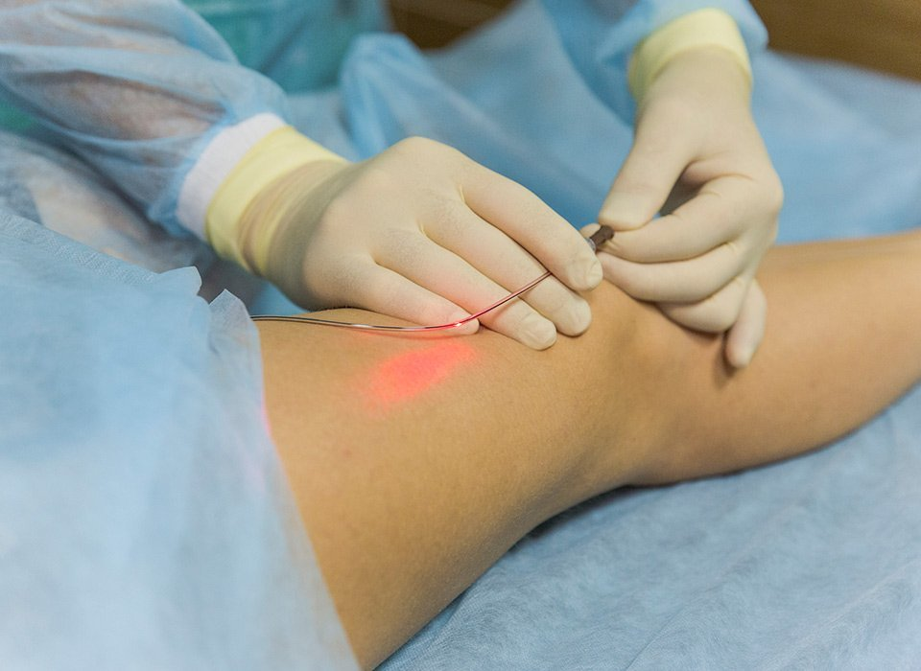
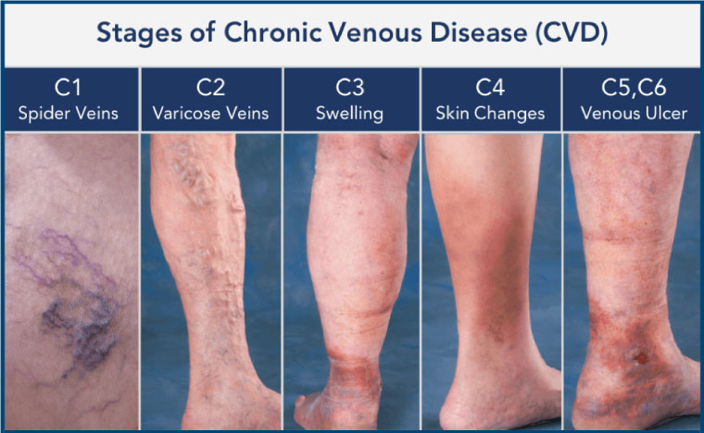
Outcome of Surgical and Percutaneous Interventions to Treat Venous Leg Ulcers:
A Single-Center Retrospective Study
Julianne Rizzo, MS2
Roslyn Rivkah Isseroff, MD, Sara E. Dahle, DPM, Daniel Link, MD, Nasim Hedayati, MD, Ramanjot Kaur, MD, and Daniel Yoon, BS
University of California, Davis - School of Medicine & VA Northern California Health System - Mather
Background
Though these procedures have been regarded as safe and minimally invasive, the use of catheters, particularly those that are chronic indwelling has been associated with risks such as sepsis and thrombosis⁸.
The risk of life-threatening complications of catheter-based therapy for VLU treatment is rare (1/1000000), but risk of ulceration from catheter use has not been evaluated.
It is possible that the puncturing of skin with a catheter may cause recurring ulceration in healing-impaired patients, especially those with underlying disease and susceptibility to chronic wounds.
Study Design
Future Implications
Chronic wounds remain a serious burden in our health system, with limited therapeutic options available to improve healing. Approximately 2.5 million people experience chronic venous insufficiency (CVI) in the U.S. alone, of which 20% develop venous leg ulcers (VLU)¹. Venous leg ulcers (VLU) are among the most common etiologies of chronic wounds, accounting for approximately 70% of ulcers².
Pathophysiology of CVI:
The exact pathogenesis of chronic venous insufficiency is not yet fully understood, but can be classified by “reflux”, “obstruction”, or a combination of the two⁹ .Venous reflux is hypothesized to be multifactorial, depending on location (superficial, deep, or perforating vascular systems)³ and is attributed to a number of mechanisms including valvular incompetence, inflammation of vessel wall, and failure of the calf muscle pump system⁴.
-Currently, there are no studies evaluating risks of cutaneous complications with catheter-based interventions for VLU treatment.
-Findings from this study will allow physicians to better estimate patient risk and outcome pertaining to catheter-based vascular intervention and VLU .
-If there is little or no correlation between the therapeutic interventions and ulceration at the site of catheter insertion, then a strong argument can be made promoting their continued use.
-Risks found in association with use of these interventions may lead to development of safer medical devices or procedures in the future.
Single-center, retrospective medical record review of patients who underwent venous percutaneous intervention(s) for the treatment of VLU between 2009 and 2019 at the VA Northern California Health Care System (VANCHS).
Patient charts will be screened and included in the study based on a limited chart review.
Inclusion criteria:
1) male or female subject of any race 18 years old or older
2) has had a venous leg ulcer or varicose veins
3) has received treatment with surgical or percutaneous vascular interventions for venous leg ulcers or venous insufficiency.
Exclusion criteria:
1) patient has a wound of non-venous etiology (i.e. arterial, burn trauma)
2) has medically documented history of HIV
3) is immunodeficient, as defined by serum IgG, IgA, and IgM less than one-half the lower limit of normal
4) is a prisoner, institutionalized individual, or part of any other vulnerable population as defined by the International Conference on Harmonization (ICH) Good Clinical Practices (GCP).
We anticipate there to be approximately 500 cases that underwent these vascular procedures in the last ten years.
After chart review, a total of 100 patients are anticipated to be needed for this review.
References
1. Eberhardt RT , Raffetto JD. Chronic venous insufficiency. Circulation 2014;130:333-46.
2. Alavi A, Sibbald RG, Phillips TJ, Miller OF, Margolis DJ, Marston W et al. What's new: Management of venous leg ulcers: Approach to venous leg ulcers. J Am Acad Dermatol 2016;74:627-40; quiz 41-2.
3. Hanrahan LM, Araki CT, Rodriguez AA, Kechejian GJ, LaMorte WW, Menzoian JO. Distribution of valvular incompetence in patients with venous stasis ulceration. J Vasc Surg. 1991;13(6):805-11
4. Bergan JJ, Schmid-Schönbein GW, Smith PD, Nicolaides AN, Boisseau MR , Eklof B. Chronic venous disease. N Engl J Med 2006;355:488-98.
5. Nicolaides AN, Trust CDEaR, Surgery ESoV, TIASACO, Angiology IUo , Cernay UIdPatAdVd. Investigation of chronic venous insufficiency: A consensus statement (France, March 5-9, 1997). Circulation 2000;102:E126-63.
6. Raju S , Neglén P. Clinical practice. Chronic venous insufficiency and varicose veins. N Engl J Med 2009;360:2319-27.
7. Jünger M, Steins A, Hahn M , Häfner HM. Microcirculatory dysfunction in chronic venous insufficiency (CVI). Microcirculation 2000;7:S3-12.
8. Goutail-Flaud MF, Sfez M, Berg A, Laguenie G, Couturier C, Barbotin-Larrieu F et al. Central venous catheter-related complications in newborns and infants: a 587-case survey. J Pediatr Surg 1991;26:645-50.
9. Youn, Young Jin & Lee, Juyong. (2018). Chronic venous insufficiency and varicose veins of the lower extremities. The Korean journal of internal medicine. 34. 10.3904/kjim.2018.230.
Objectives
1) Explore the correlation(s) between catheter-based vascular intervention procedures for VLU treatment and ulceration.
2) Evaluate the efficacy of vascular intervention procedures.
Diagnosis and Treatment:
Diagnostic tools used to diagnose CVI including ankle brachial index (ABI) tests, duplex ultrasound, and pulse oximetry^{5,6}.
Compression therapy is an effective and non-invasive mainstay standard of care in treating CVI⁷. Percutaneous interventions are now recommended and include radiofrequency therapy, endovascular laser ablation, and ultrasound-guided foam sclerotherapy.
Hypothesis
Acknowledgements
We hypothesize that 10% of patients will develop a secondary wound from the insertion site that undergoes percutaneous vascular intervention.
I would like to thank Dr. Roslyn Rivkah Isseroff and Dr. Sara Dahle for their support and guidance, the Medical Student Research Fellowship, the Dean’s Discretionary Research Fund, and the Lillian Mae Rapp Endowment Fund.

